Slide 1

PHP Sort Arrays & Super Globals Var.
Umer Shahzad

Slide 2
PHP, arrays can be sorted using several built-in functions. Some of the most commonly used functions are:
Umer Shahzad

Slide 3
sort() - sort arrays in ascending order rsort() - sort arrays in descending order asort() - sort associative arrays in ascending order, according to the value ksort() - sort associative arrays in ascending order, according to the key arsort() - sort associative arrays in descending order, according to the value krsort() - sort associative arrays in descending order, according to the key
Umer Shahzad

Slide 4
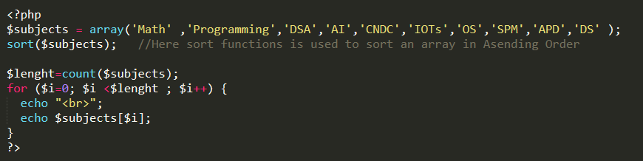
Syntax of Sort() Method:

Slide 5
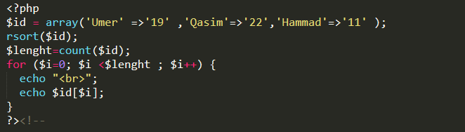
Syntax of rsort() Method:

Slide 6
PHP Super Globals:
In PHP, superglobals are special variables that are always available in all scopes of a script. Some of the most commonly used superglobals are:

Slide 7
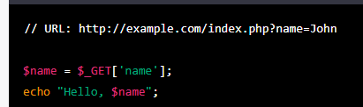
PHP $GET:

Slide 8
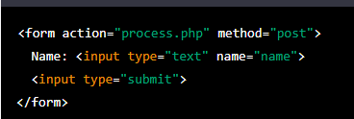

PHP $POST:

Slide 9
PHP SUPER GLOBAL….
$_SESSION
$_GET
$_POST
$_COOKIE
$_ENV
$_REQUEST
$_GLOBAL

Slide 10
Thank You! For Giving Your Important Time. “Keep Learning & Keep Exploring”.

